Slide 1
Sentiment Analysis / Classification
KALALA KABAMBI David
NANFACK MATTHIEU
Marty Julien

Slide 2
Problem framing
Sentiment analysis / classification on books review
Dataset : Amazon books review
Input:
Review helpfulness [0, 1]
Review summary (text)
Review text (text)
Output:
Vector of length 5, representing the probability density function of the 5 classes

Slide 3
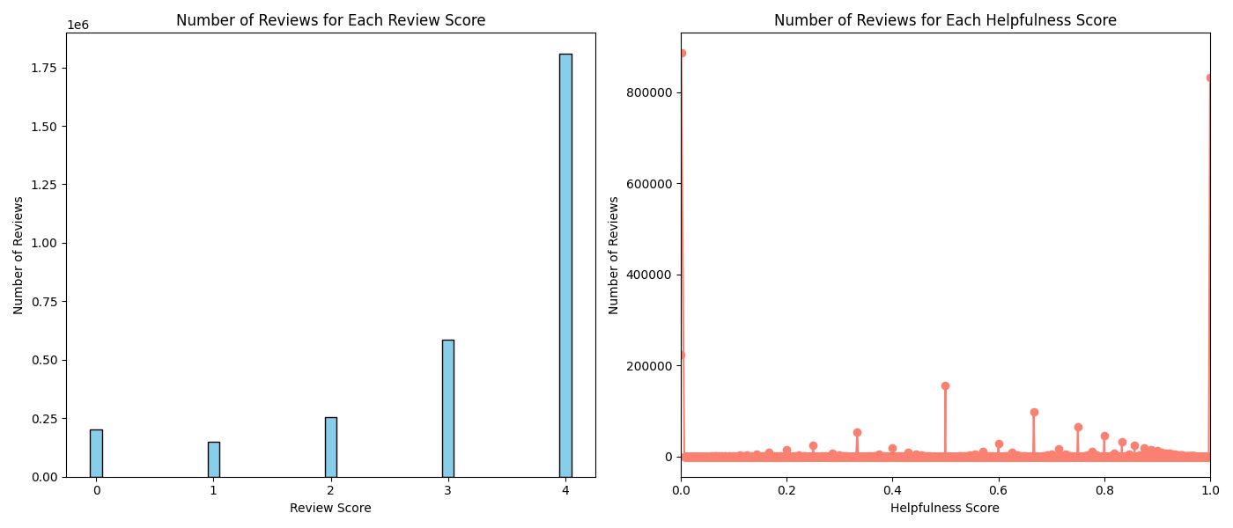
Data cleaning and preparation
Very imbalanced dataset :
3 m samples
1.8 m 5 stars rating
0.7 m 4 stars rating
Helpfulness score is the is an opinion given by other users on the review, helpful or nor (binary)
Helpfulness score :
0.9 m 0 helpfulness
0.9 m 1 helpfulness

Slide 4
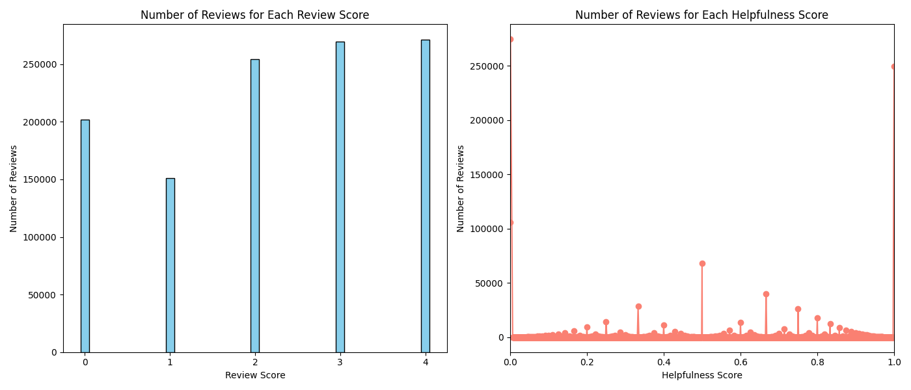
Data cleaning and preparation
Randomly remove some parts of the dataset :
85% of the 5 stars review
54% of the 4 stars review
This allowed to have a more balanced dataset
Review helpfulness keep the same Density

Slide 5
Data cleaning and preparation
The model output is a vector representing probabilities for each classes
In the dataset we have scores from 1 to 5 as integers values
Needed to convert the input to a vector of length 5 as input
All the values in the vector are 0 except the index that represent the score which is 1
Each value in the output vector, represent the probability of the class that correspond to the index in the vector
Example : If the input is a 5 stars review, we want the input to be [0, 0, 0, 0, 1]
We want the probability density function outputted by our model to be as close as the input [0, 0, 0, 0, 1] as possible

Slide 6
Model selection
Used Deep Learning models
We chose BERT model
The best in natural language understanding
We tried BERT but also used the DistilBERT model because it is less complex and can reduce overfitting

Slide 7
Training
Used cross entropy loss
Used for multiclass classification
Designed to work with raw output (without softmax on the model output)
Adam optimizer
Allow adaptative learning rate
Great optimizer overall
Trained on AMD GPU with ROCm docker image

Slide 8
Fine-Tuning : Model 1
We had a lot of over fitting despite using a large number of samples
This is because we used the imbalanced dataset to show the importance of having a balanced dataset
Model BERT (complex model, maybe too complex for our data)
200.000 samples
5 epochs
To avoid overfitting :
Weight decay
Learning rate scheduler (10% - 15% warmup step)

Slide 9
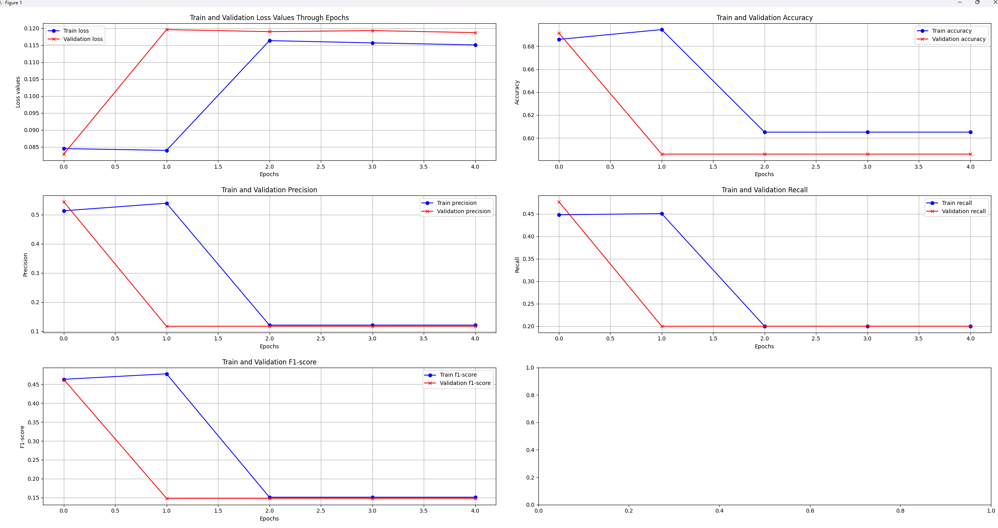
Model 1

Slide 10
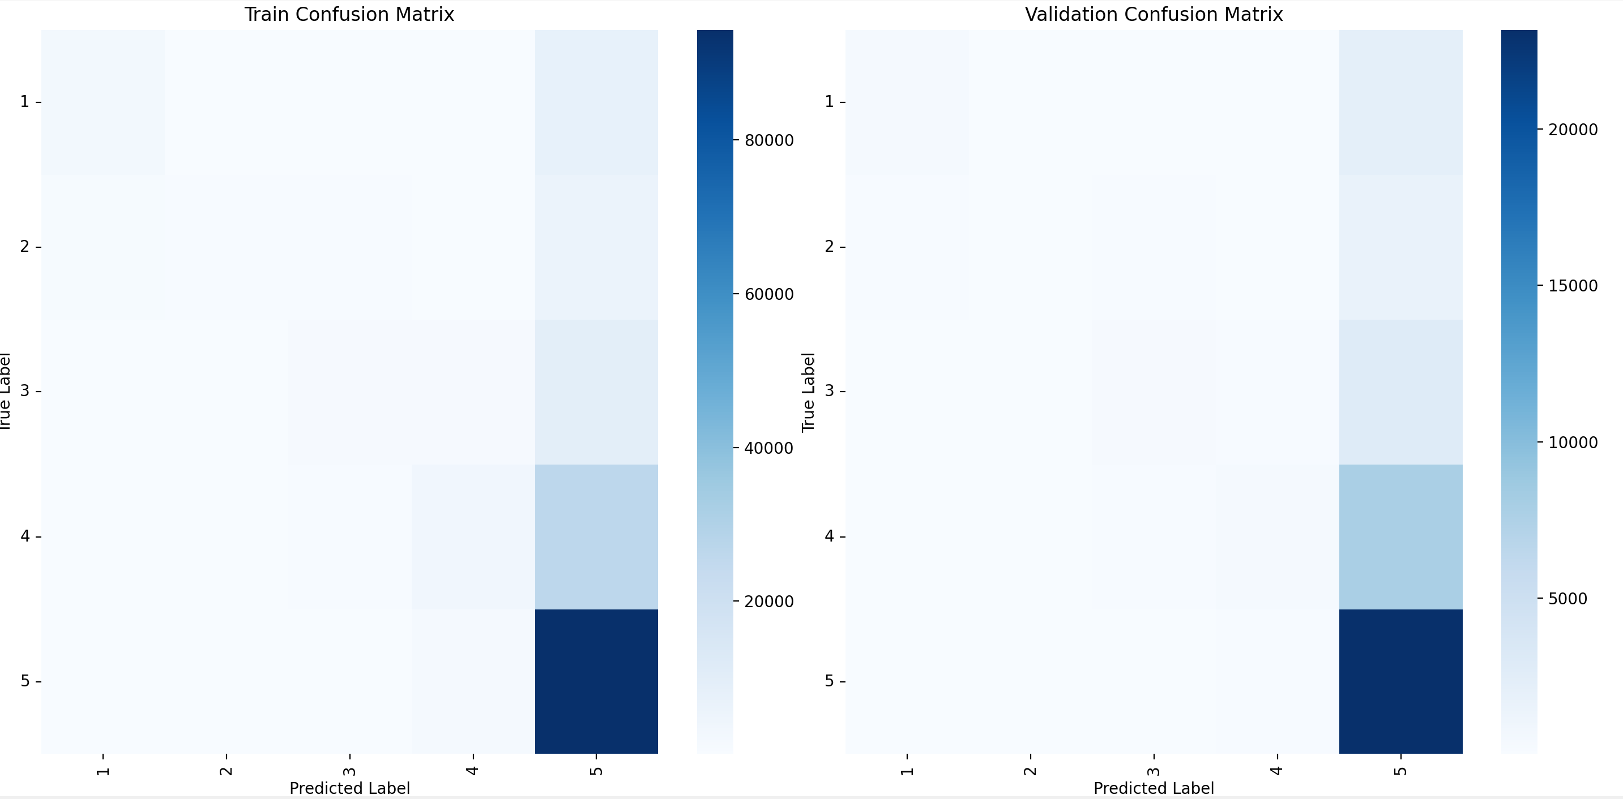
Model 1
A lot of confusion with the class number 5
Over represented in the dataset

Slide 11
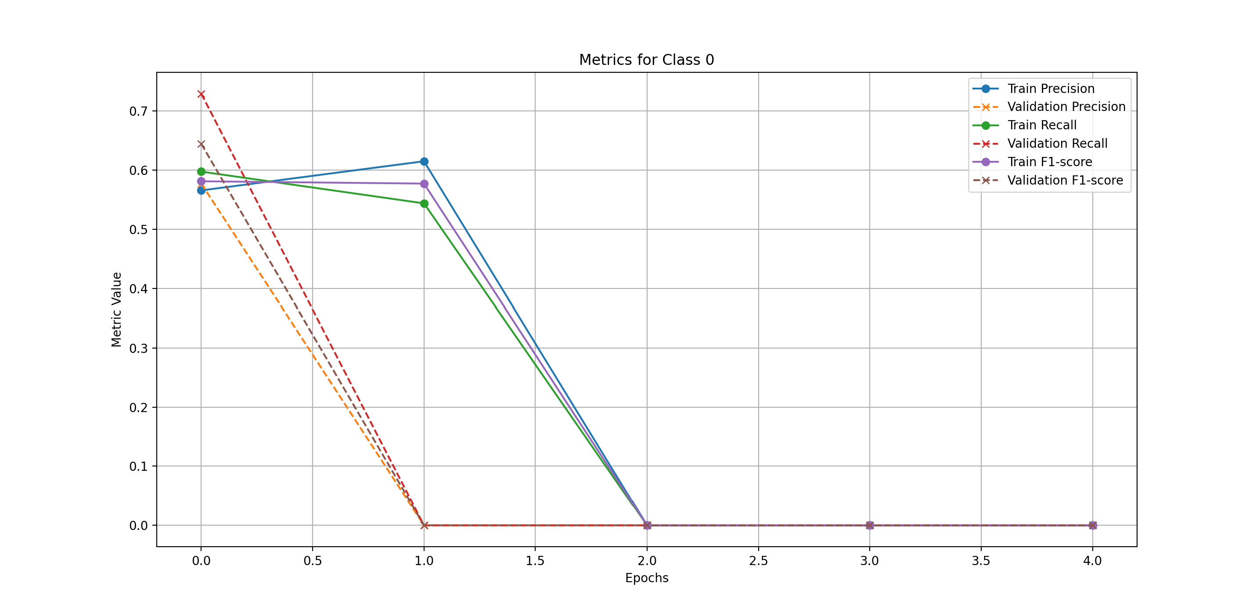
Model 1

Slide 12
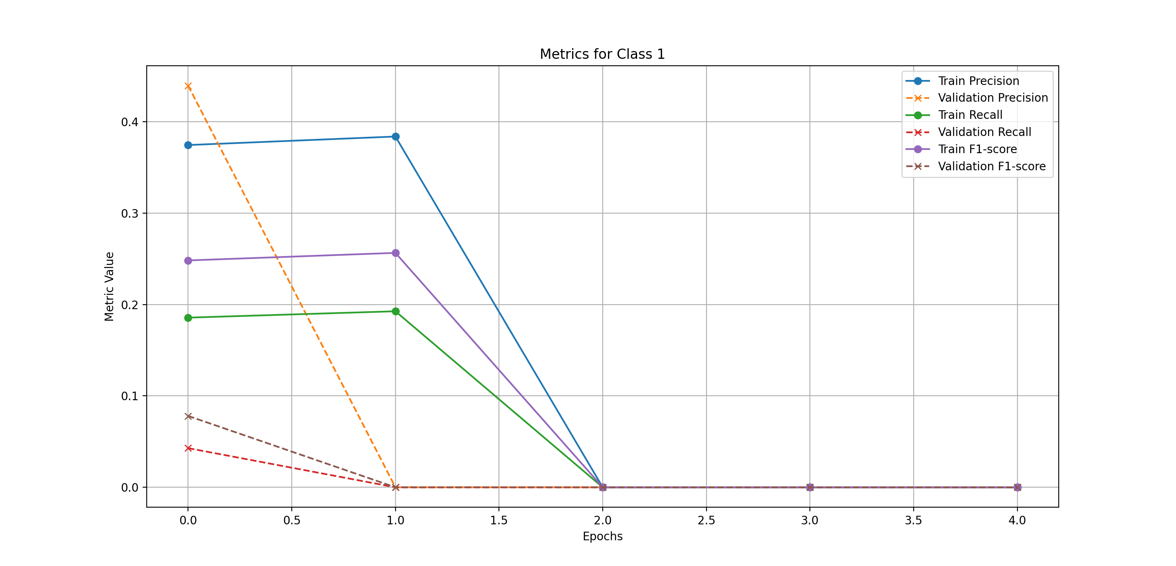
Model 1

Slide 13
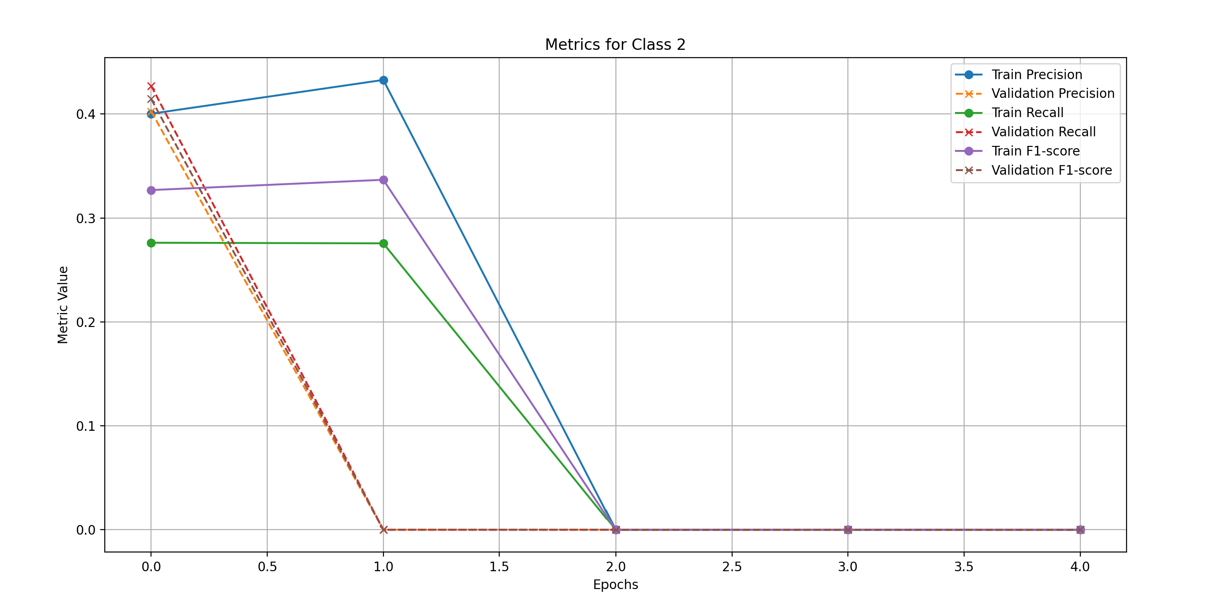
Model 1

Slide 14
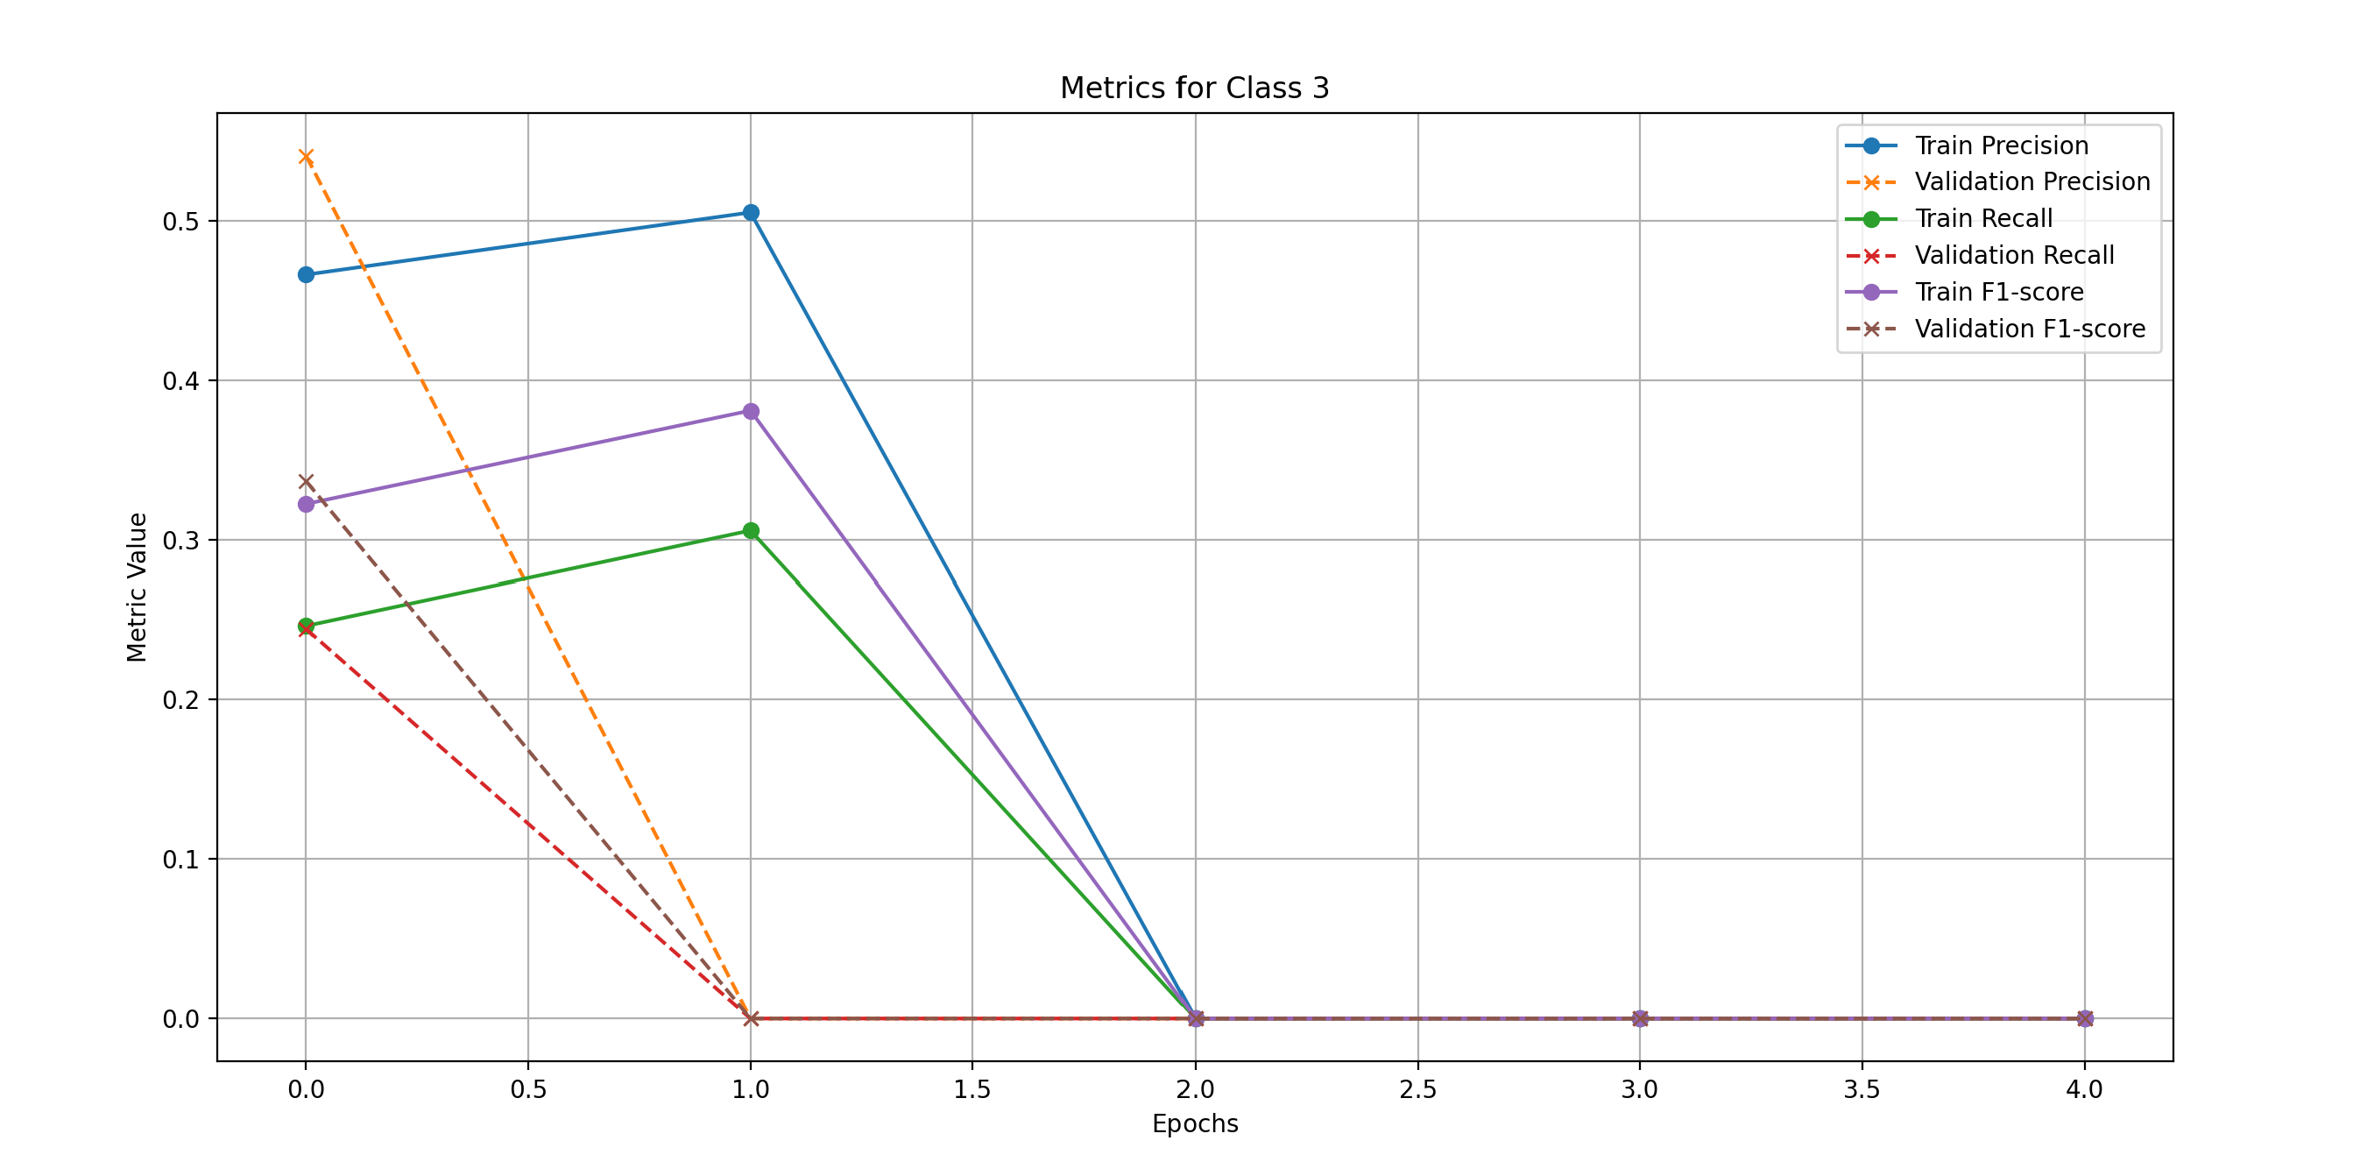
Model 1

Slide 15
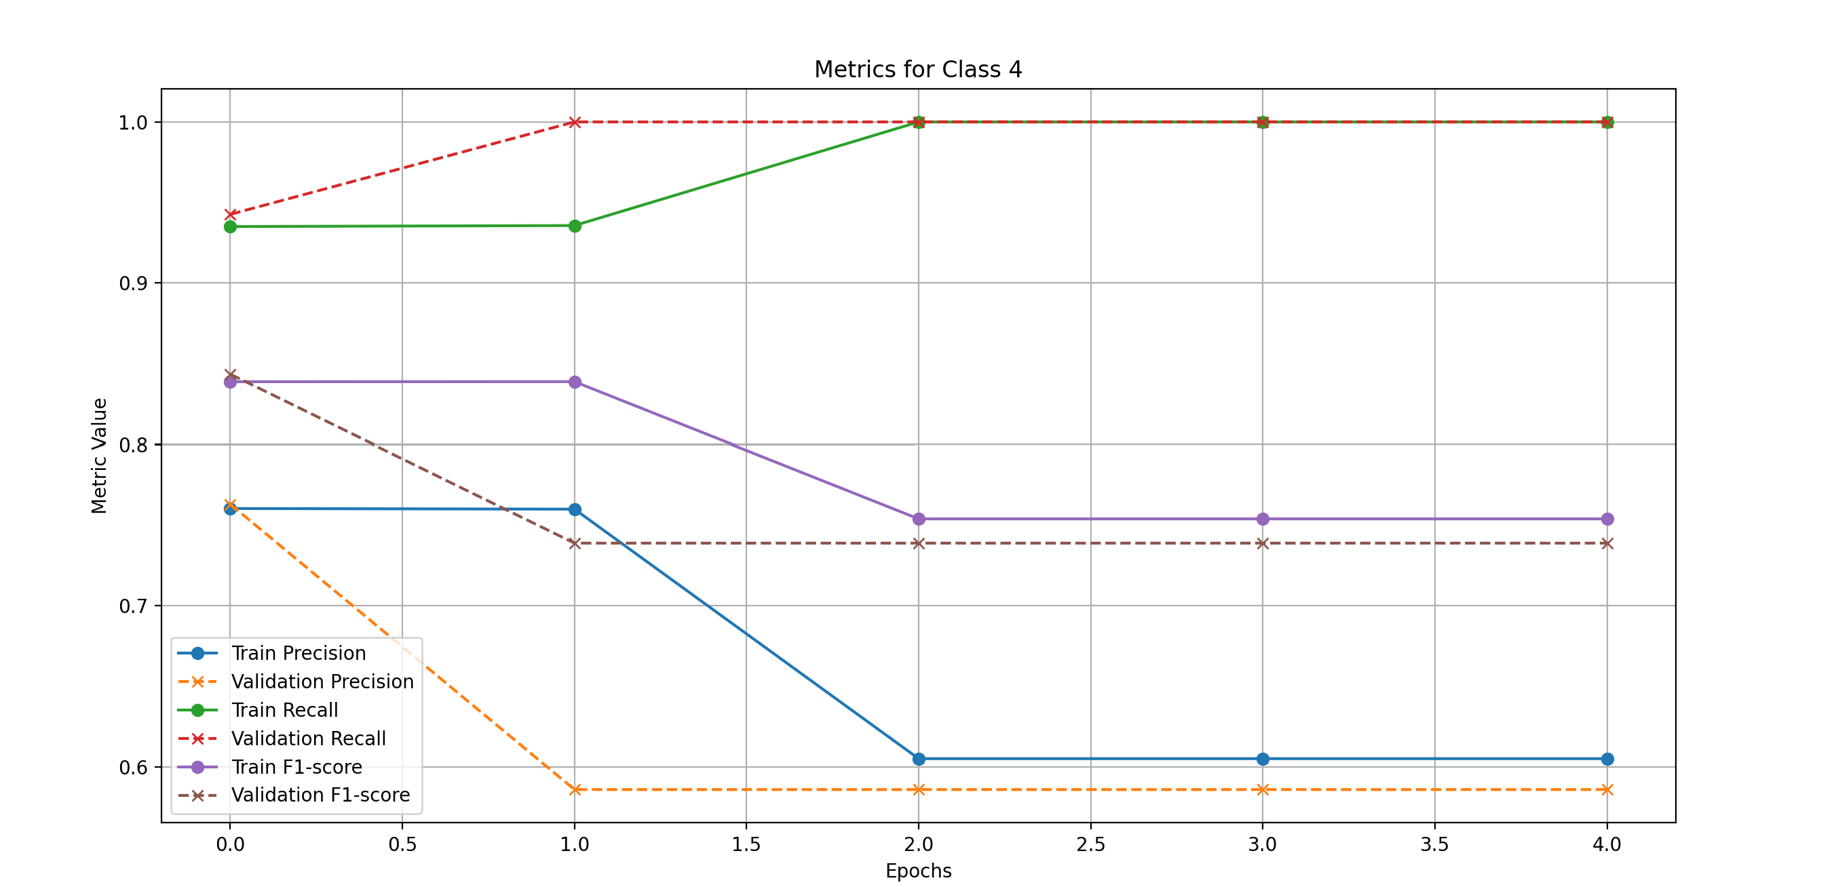
Model 1

Slide 16
Fine-Tuning : Model 2
Model DistilBERT : Less complex model to avoid overfitting
35.000 samples
13 epochs
Balanced dataset
To avoid overfitting :
Weight Decay
Feezed the first 4 layers of the model
Learning rate scheduler (10% - 15% warmup step)
Different learning depending of the layers (smaller for the already trained DistilBERT layers)
Dropout
Early stopping

Slide 17
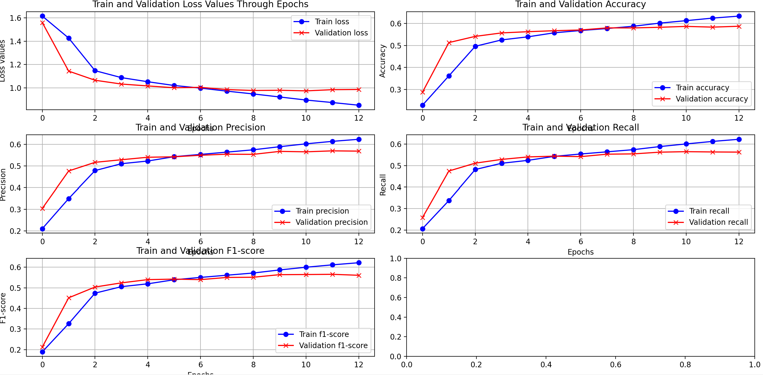
Model 2

Slide 18
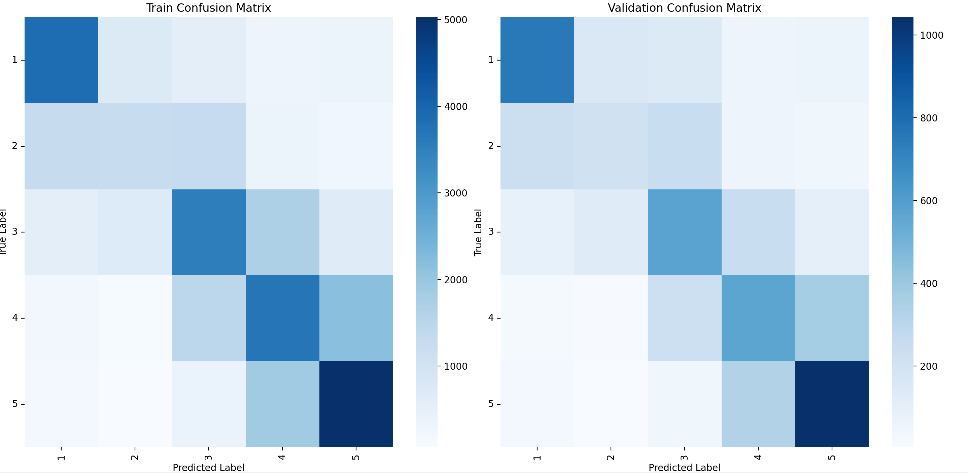
Model 2
No more confusion with the 5th class because of the more balanced dataset

Slide 19
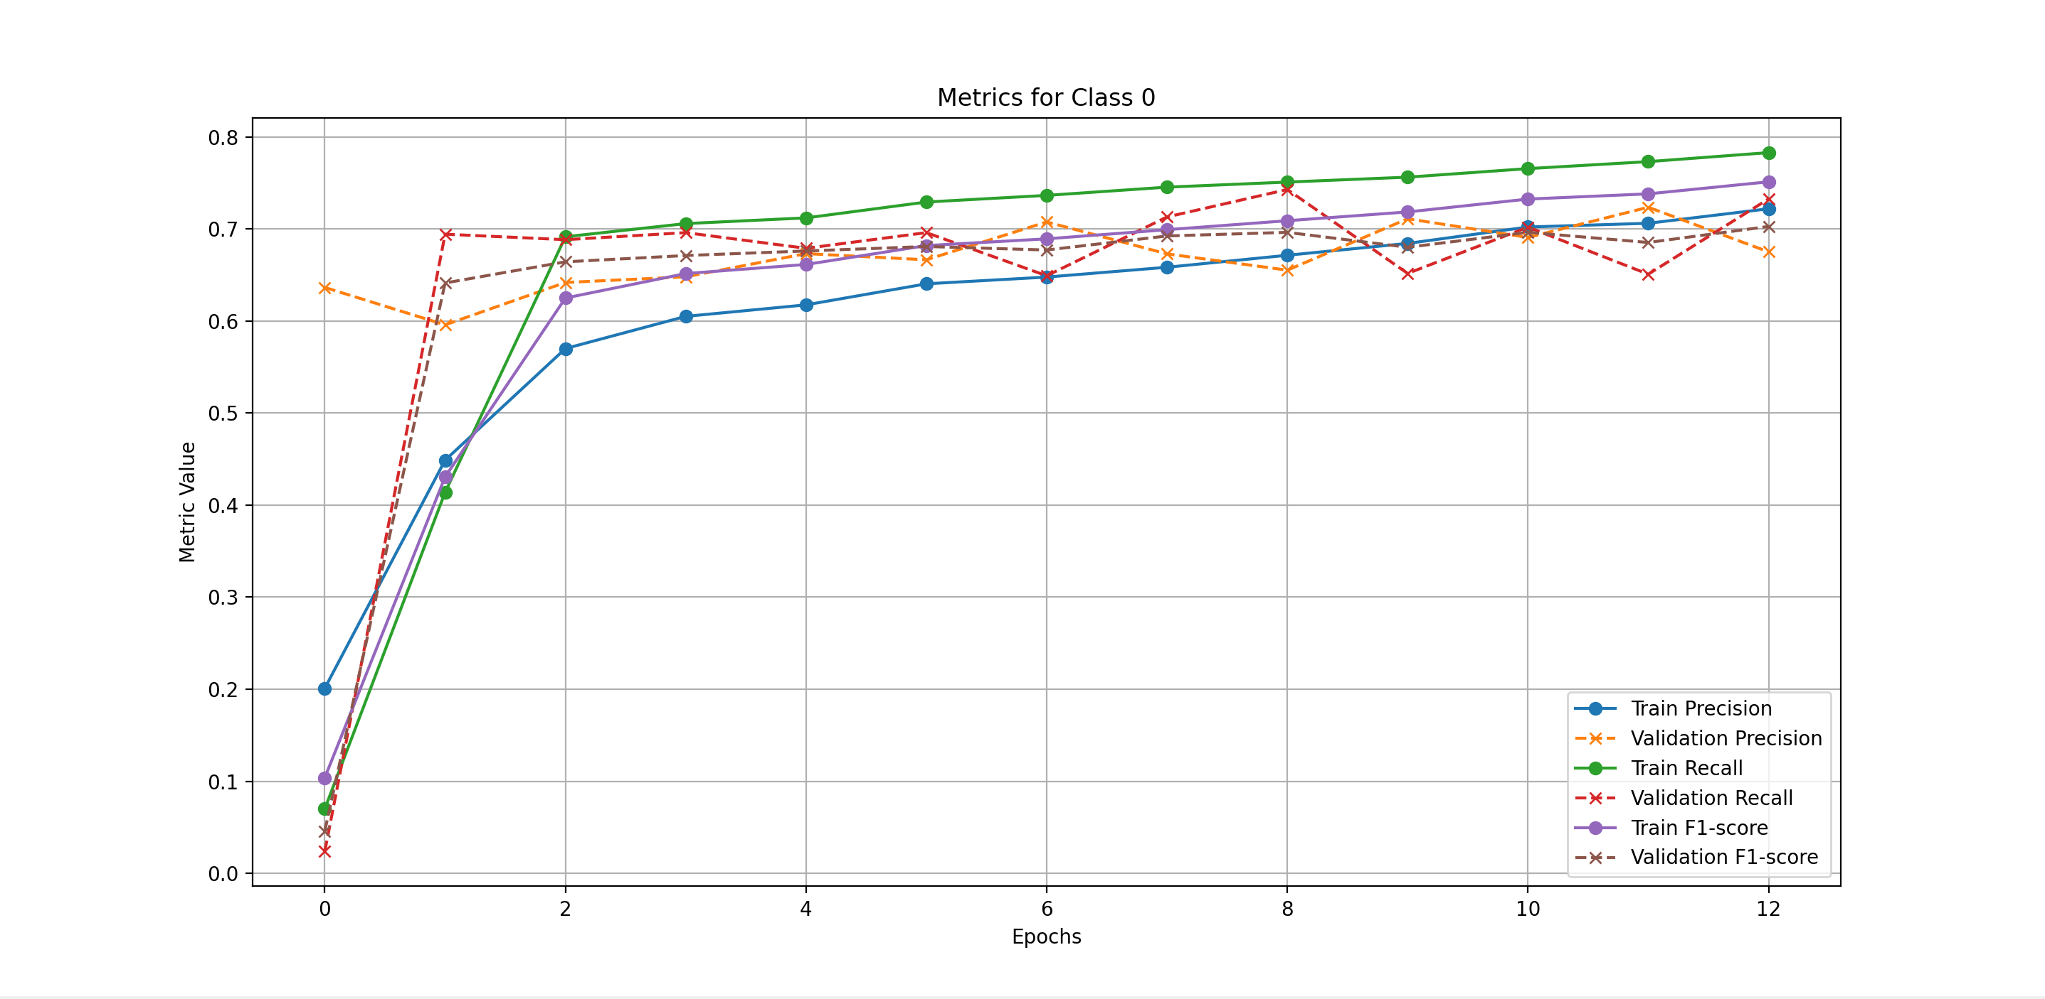
Model 2

Slide 20
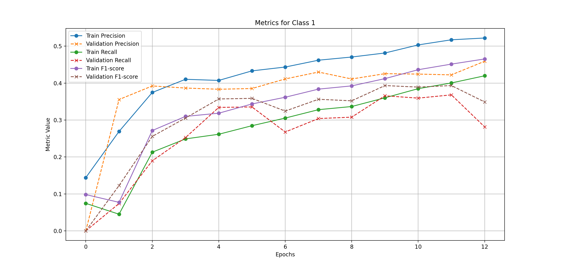
Model 2

Slide 21
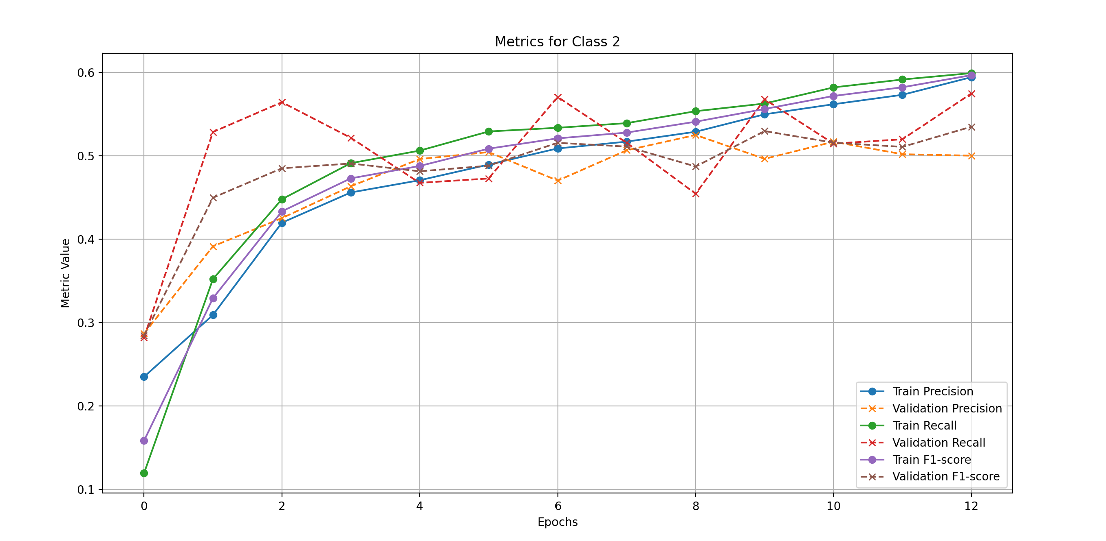
Model 2

Slide 22
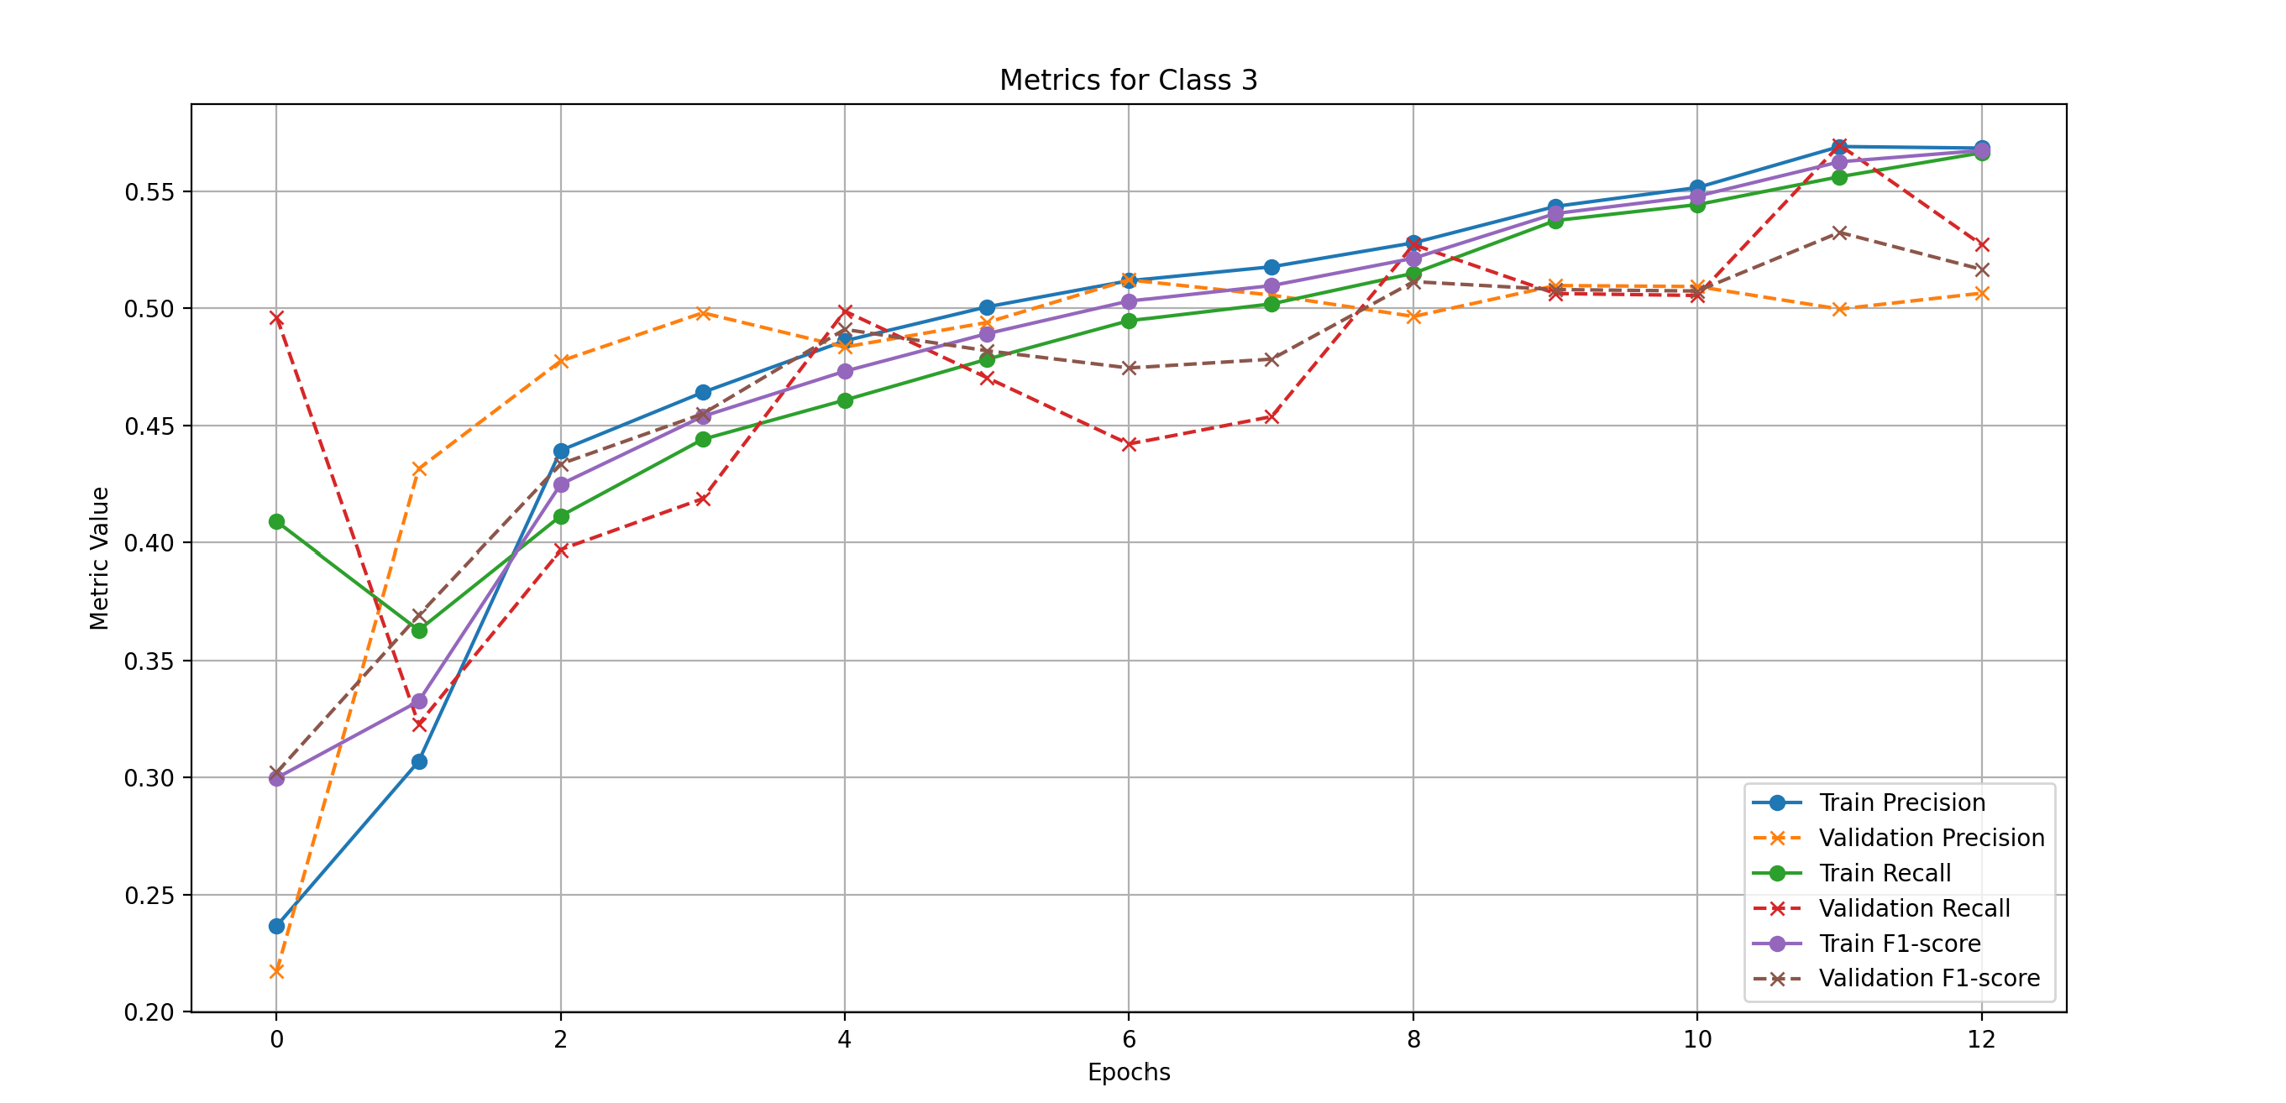
Model 2

Slide 23
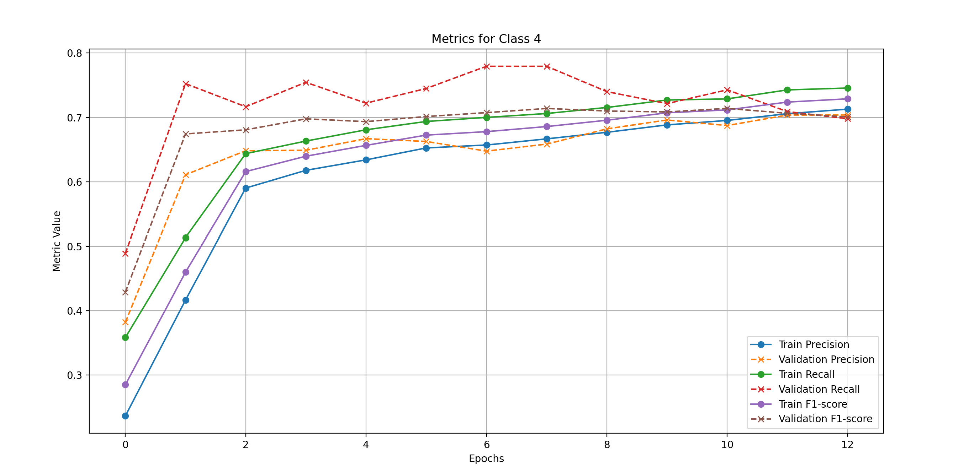
Model 2

Slide 24
Fine-Tuning : Model 3
Model DistilBERT
Tried another approach for comparison, a lot of samples with only one epoch
200.000 samples
1 epoch
Balanced dataset
To avoid overfitting:
Weight Decay
Froze the first 4 layers of the model
Learning rate scheduler (10% - 15% warmup step)
Different learning depending of the layers layers (smaller for the already trained DistilBERT layers)
Dropout
Similar average results but with a lot of variance in metrics values within the classes

Slide 25
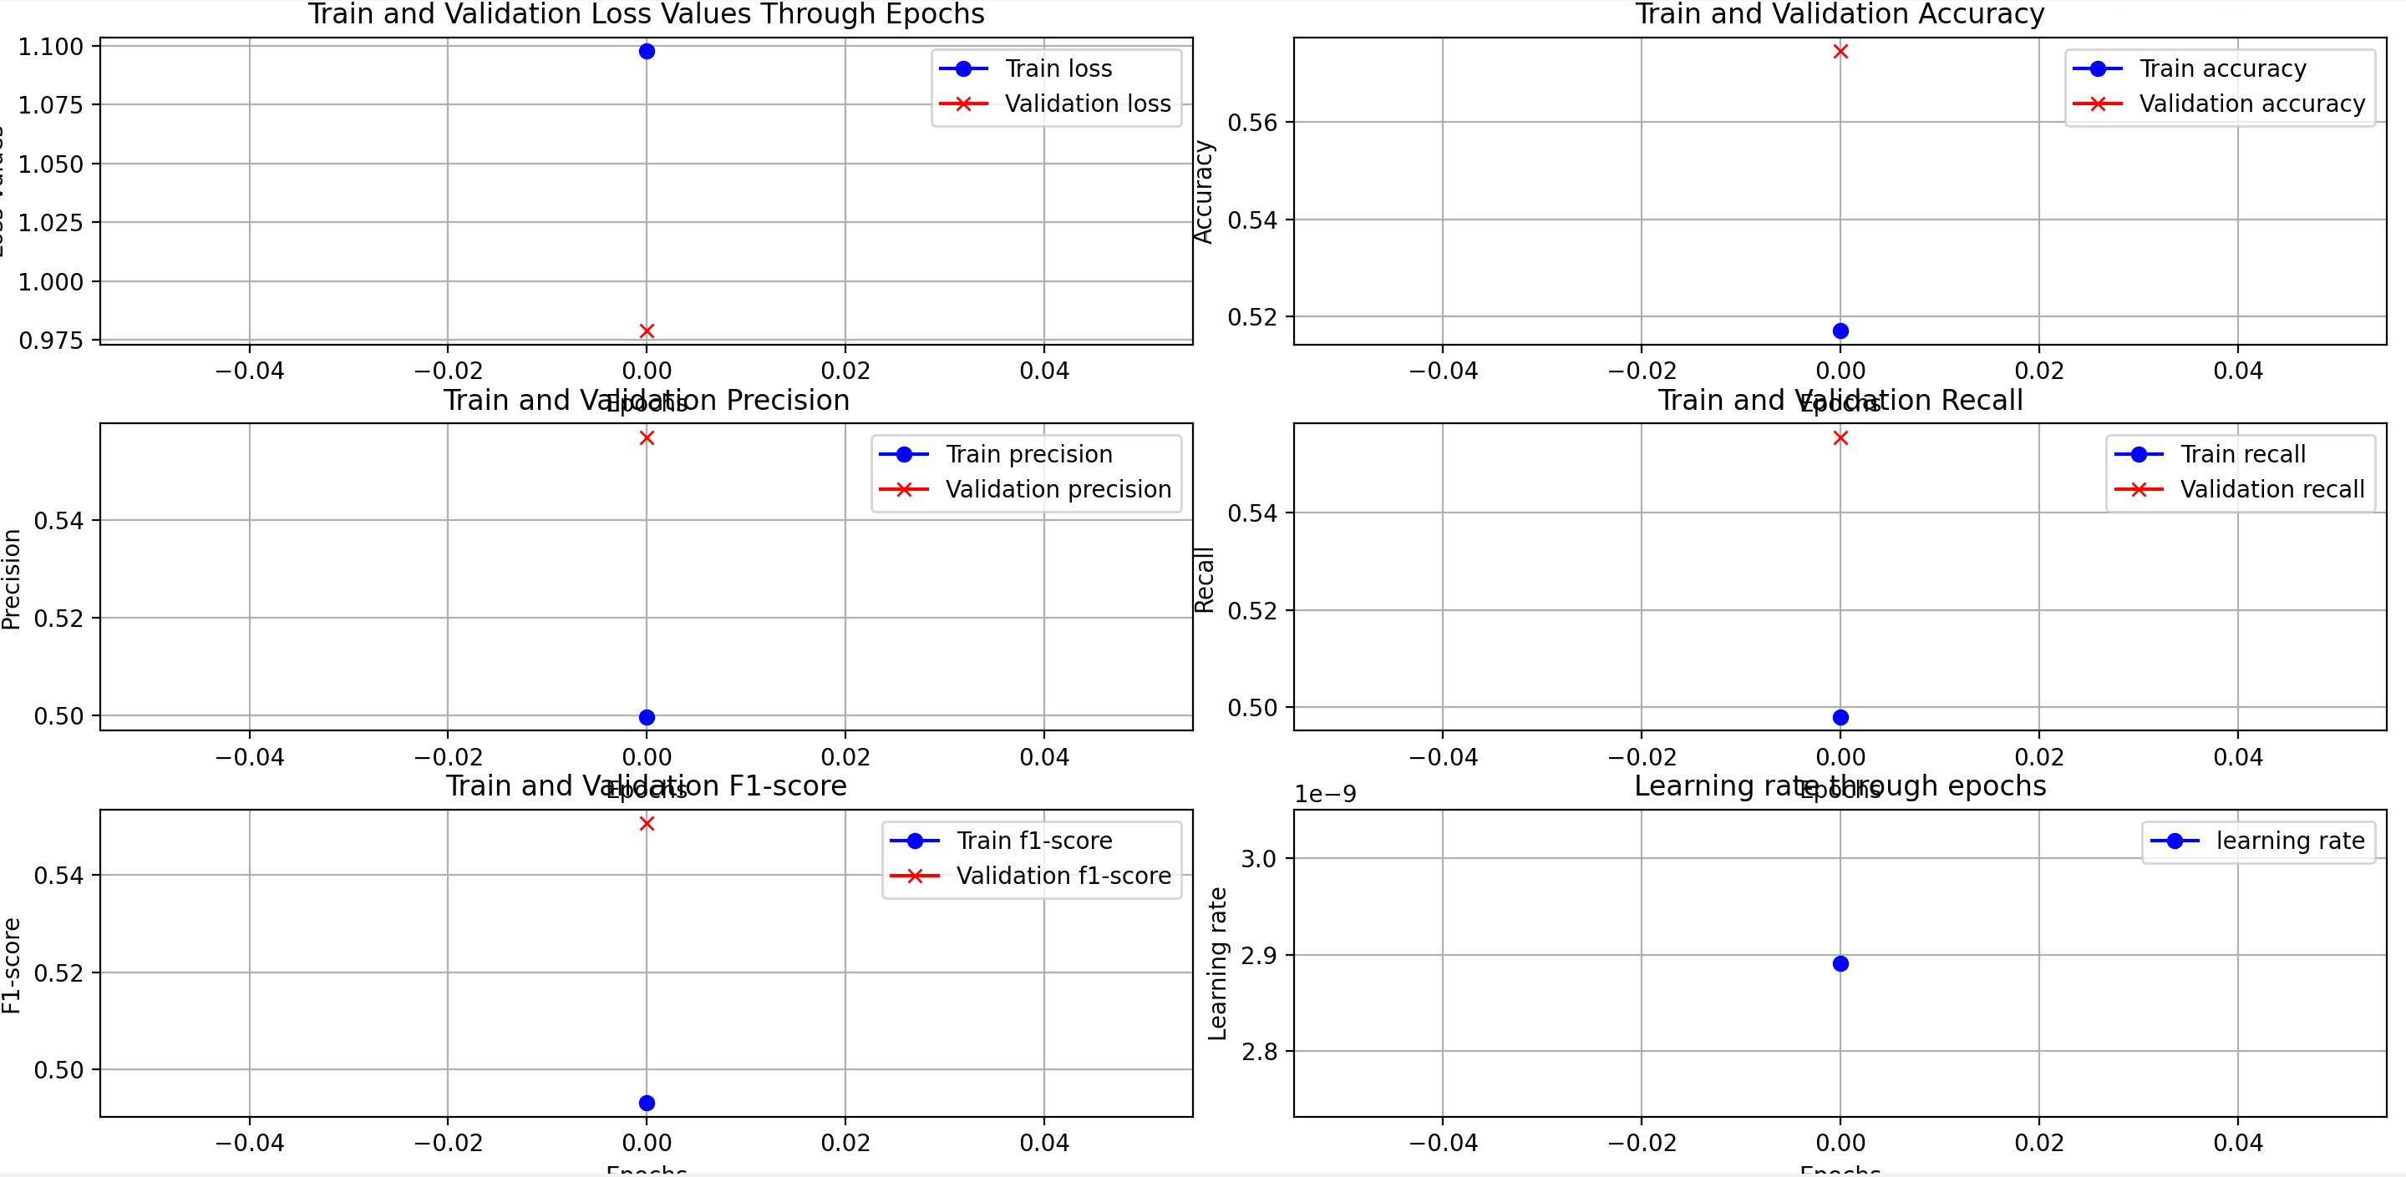
Model 3
Not very representative, because we trained for only one epoch

Slide 26
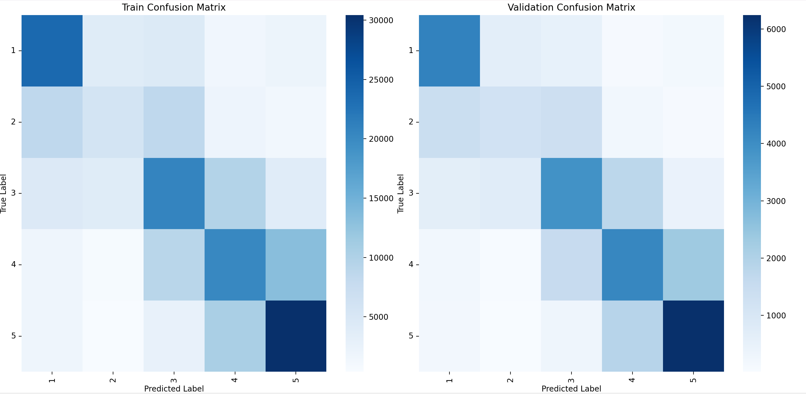
Model 3
Similar confusion matrix in comparison with fewer samples and more epochs for training

Slide 27
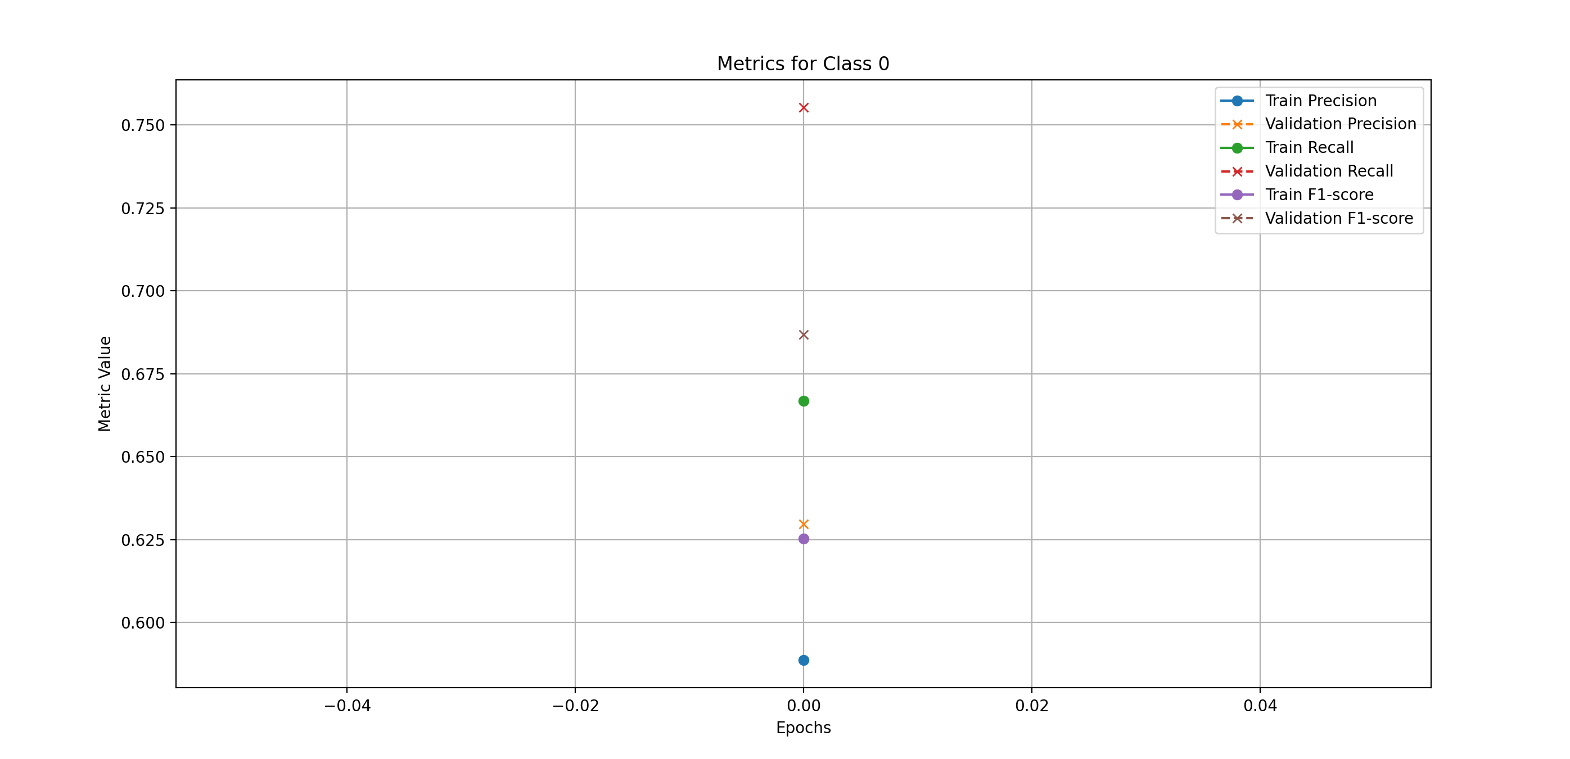
Model 3
The results are a little worse but still pretty close in comparison with fewer samples and more epochs for training

Slide 28
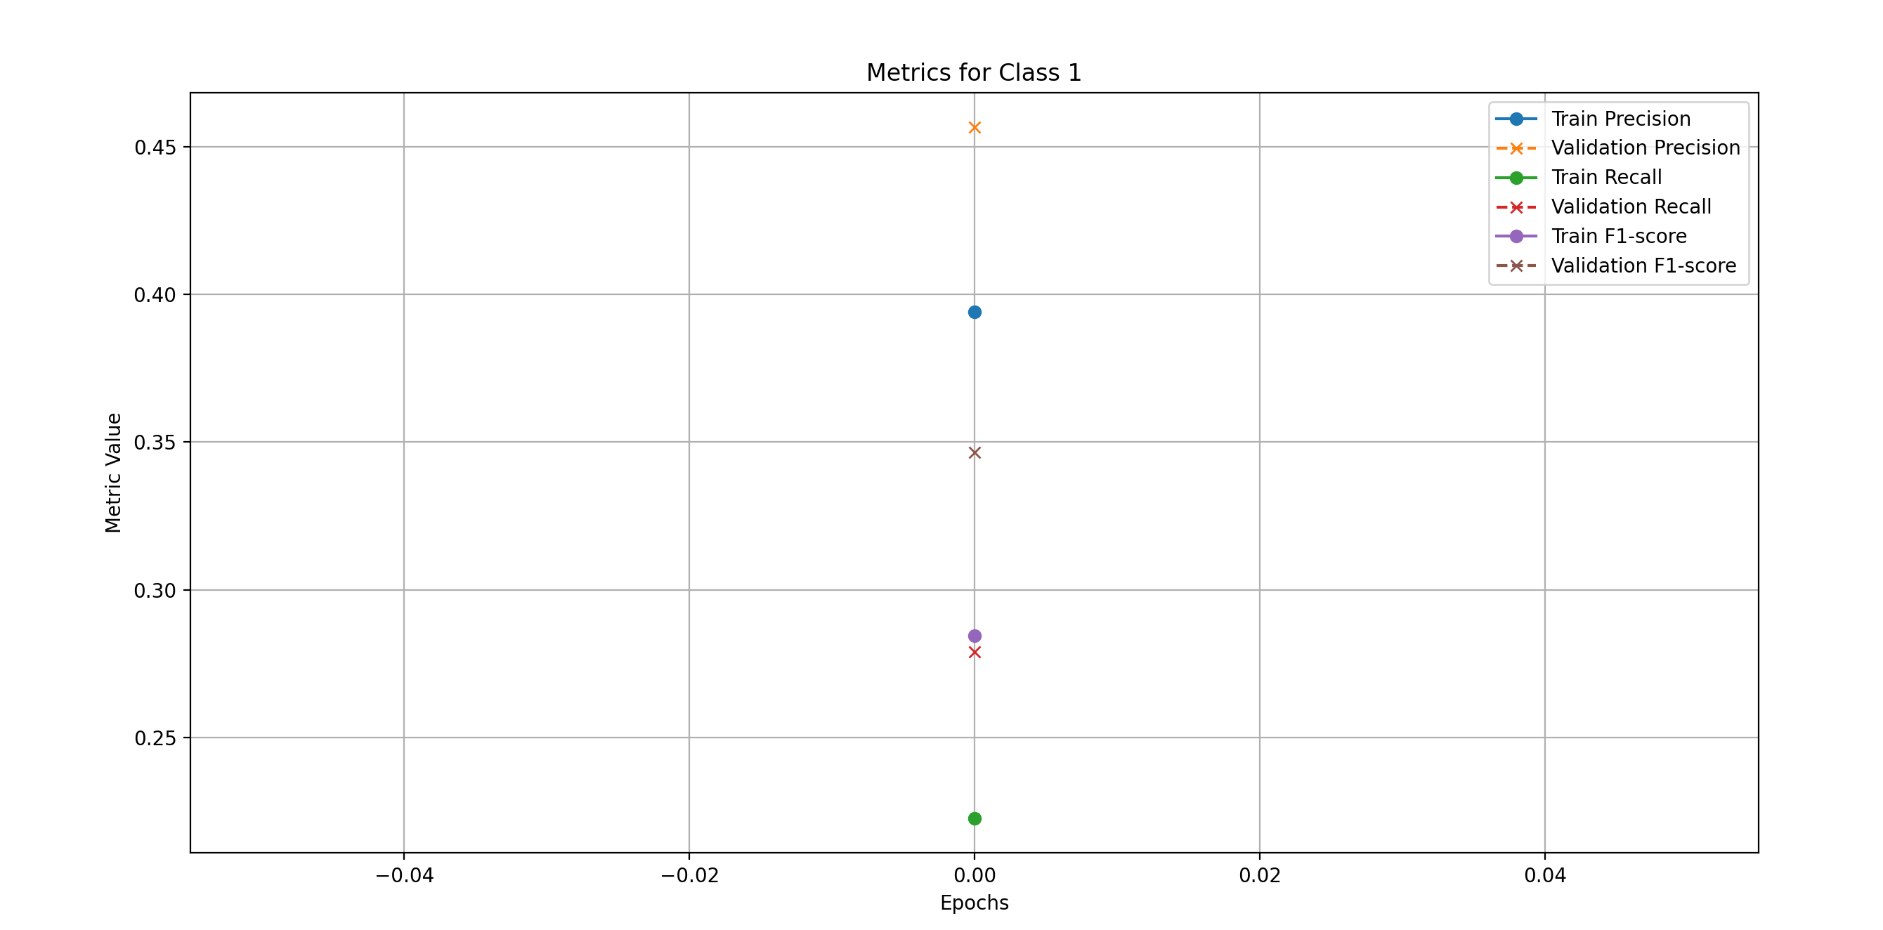
Model 3
Class least represented in the dataset, the results are similar in comparison with fewer samples and more epochs for training

Slide 29
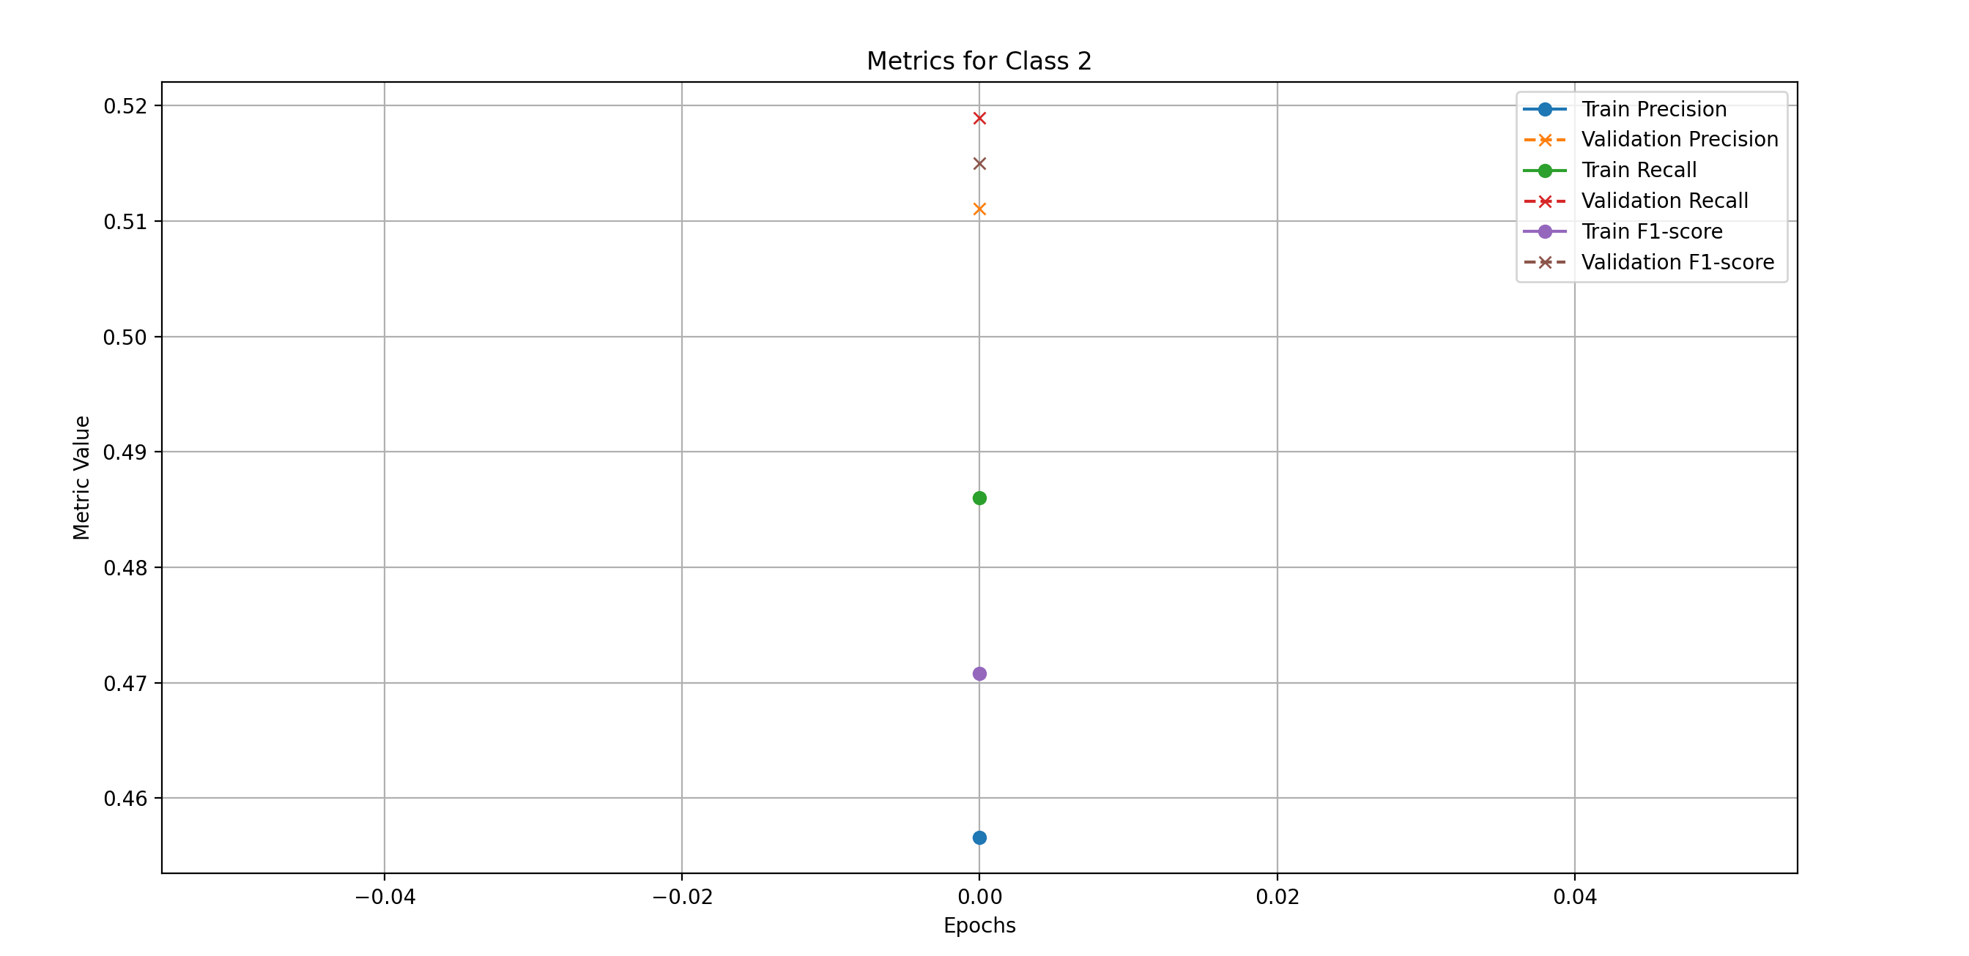
Model 3
The second least represented class in the dataset, the results are very close in comparison with fewer samples and more epochs for training

Slide 30
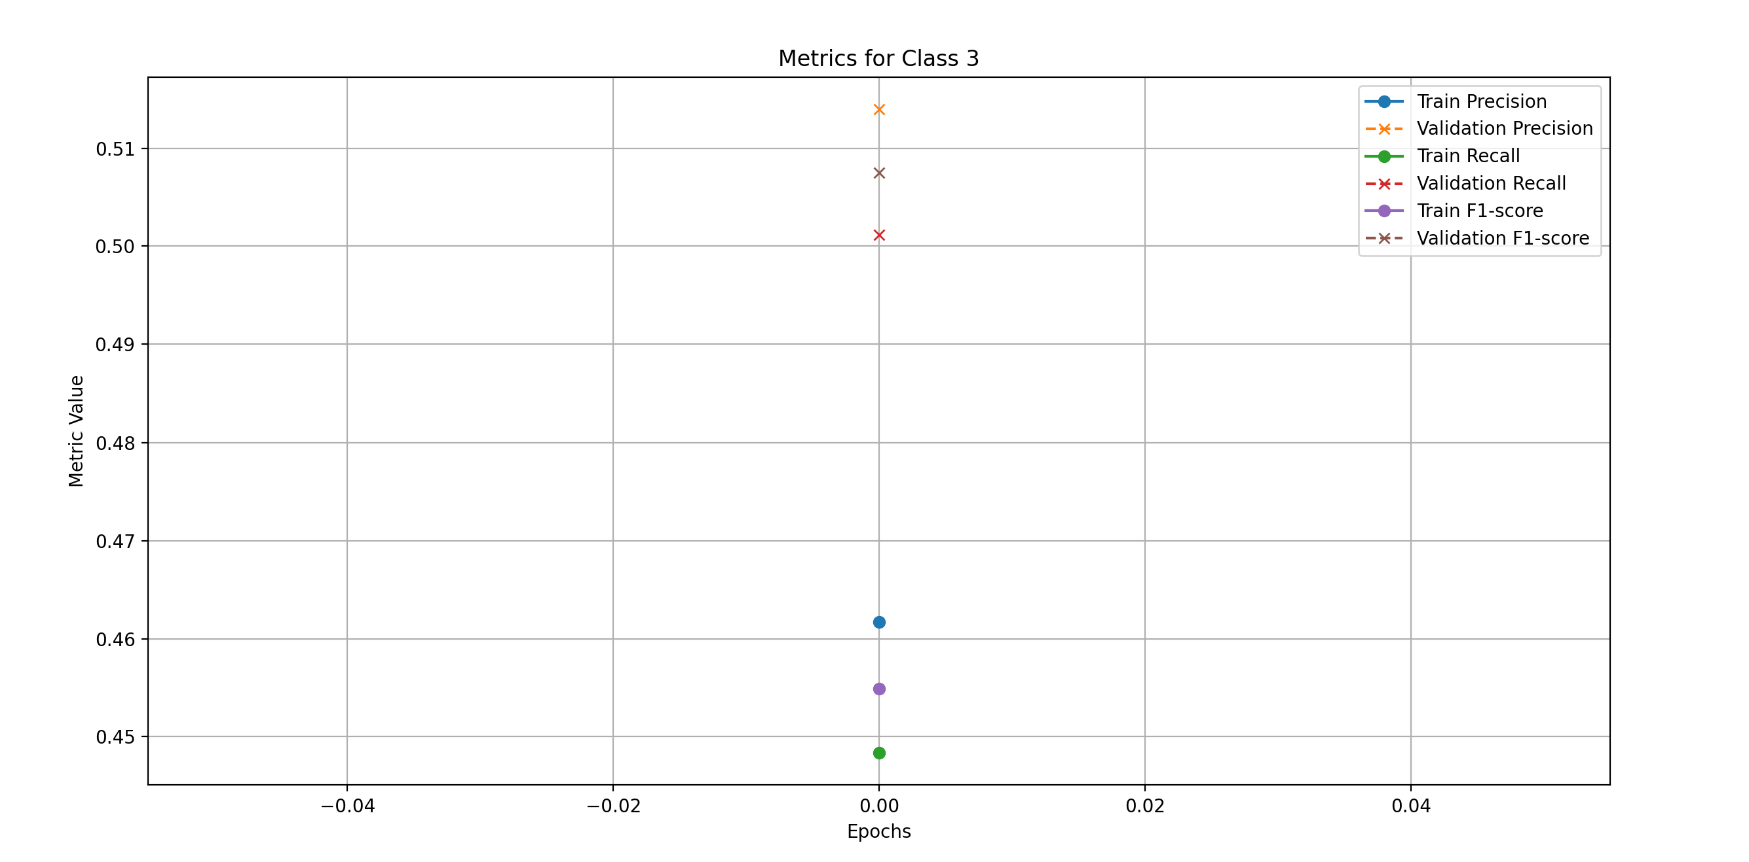
Model 3
The second most represented class in the dataset, results a little worse in comparison with fewer samples and more epochs for training

Slide 31
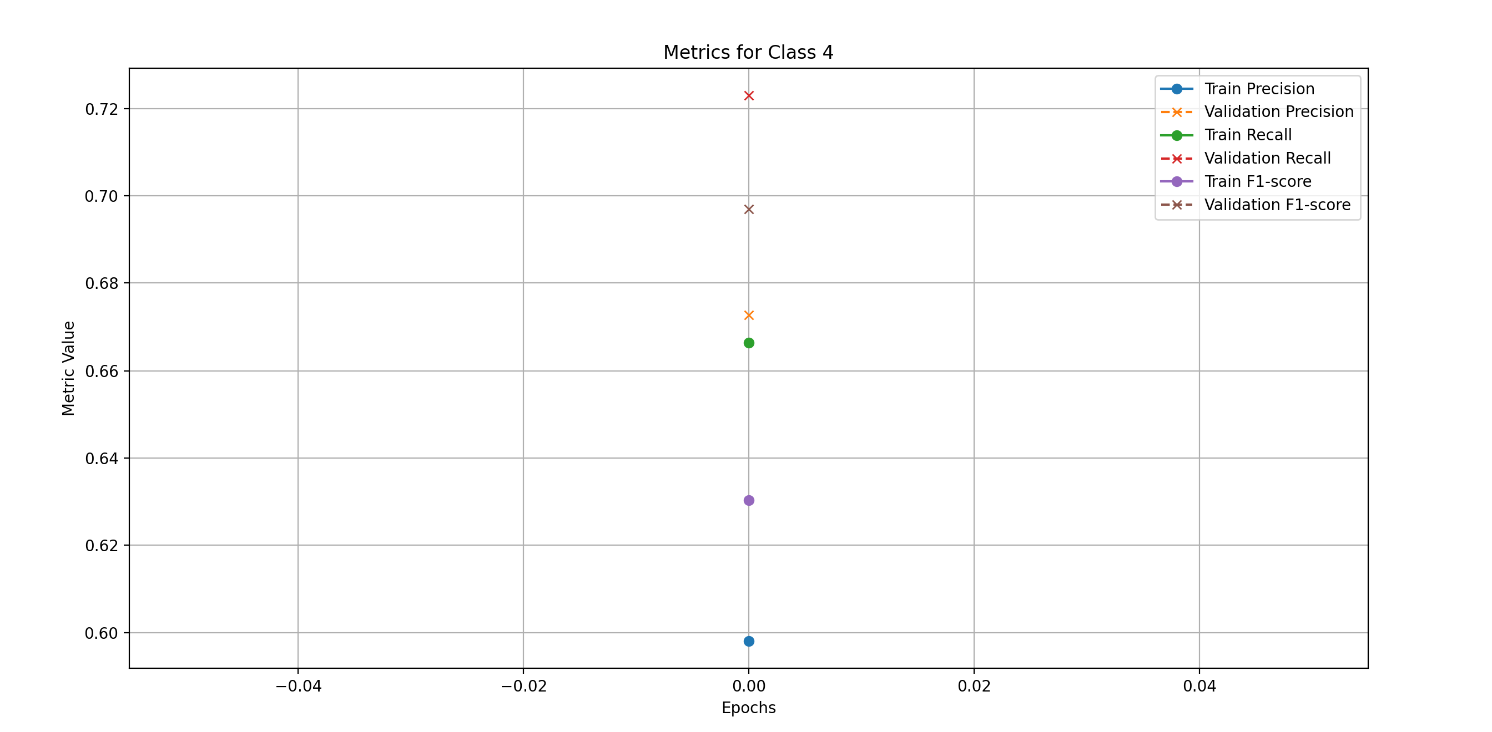
Model 3
Most represented class in the dataset, the results are a little worse, the metrics values have more variance in comparison with fewer samples and more epochs for training

Slide 32
Model 3
Conclusion on model 3 metrics
For all the classes, the results are similar or a bit worse but the metrics within the class have more variances in comparison with fewer samples and more epochs for training.

